Slide 1
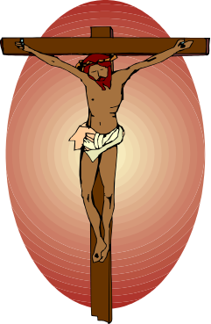


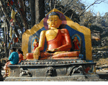
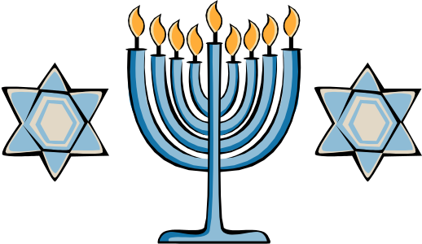
ISLAM AND COMPARATIVE RELIGIONS

Slide 2
Religions of the World
Religion | Followers
Christianity | 1.9 billion
Islam | 1.1 billion
Hinduism | 781 million
Buddhism | 324 million
Sikhism | 19 million
Judaism | 14 million

Slide 3
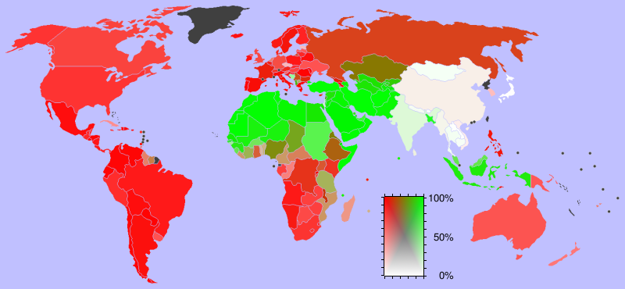
Religions of the World
Red = Christianity, Green = Islam

Slide 4
SOUTHWEST ASIA
The three religions that began in Southwest Asia are:
Judaism (2000 BCE)
Christianity (26-36 CE)
Islam (610 CE)

Slide 5
Buddhism
Buddhism is related to Hinduism and shares many of the same basic beliefs. The relationship between Buddhism and Hinduism is similar to the relationship between Christianity and Judaism.

Slide 6
BUDDHISM
This religion does not explain any socio-economic aspects of human life: it basically relies on the spiritual ecstasy (smoothness).
The literature of this religion is in PALI language and its all in verbal.

Slide 7
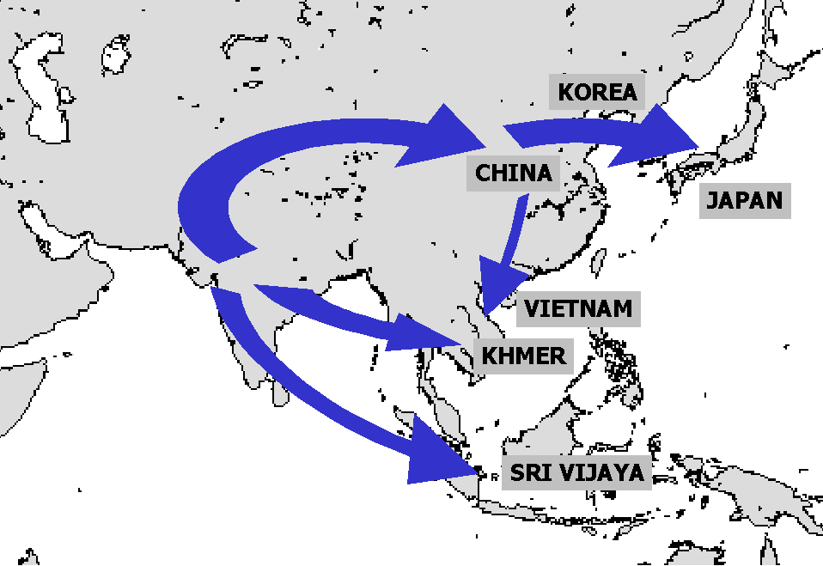
Buddhism

Slide 8

BUDDHISM
In 563 BC, Prince Siddhartha Gautama was born in Nepal.
Grew up wealthy & sheltered.
Never allowed to see pain, death, illness or poverty due to a prophecy.

Slide 9

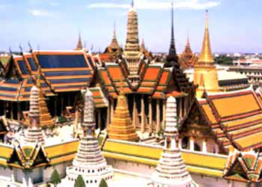
THE PRINCE
Prince leaves palace & realizes the world is full of pain & misery.
Wants to find answer why & how to stop it.
Travels the world & meditates under tree for 49 days.

Slide 10
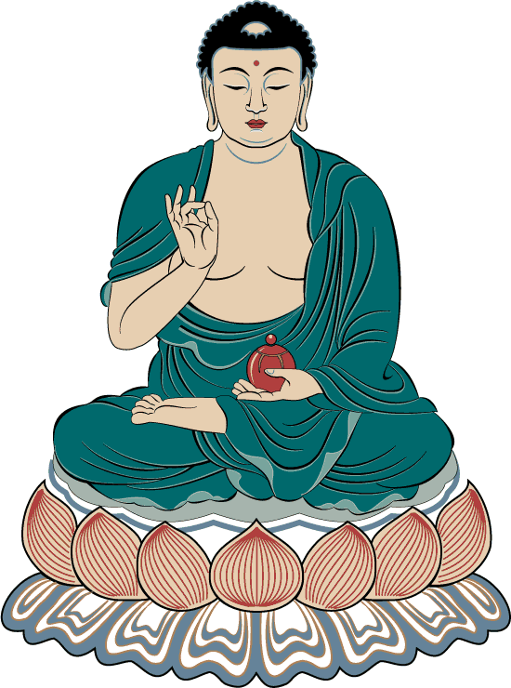
THE BUDDHA
Prince found his answers.
He became known as the Buddha, the “Enlightened One” as he traveled the world to teach his beliefs.

Slide 11
THE FOUR NOBLE TRUTHS
1. Suffering is universal- everyone feels pain
2. Cause of suffering is desire- (riches, objects,)
3. Only way to end suffering, is to crush desire
4. Way to end desire is to
follow the Noble 8 Fold Path

Slide 12
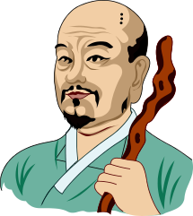
THE NOBLE 8-FOLD PATH
1.Right Speech (Samma Vaca)
2.Right Action (Samma Kammo)
3. Right Livelihood (Samma Ajivo)
4.Right Exertion or right effort (Samma Vayamo)
5. Right Awareness (Samma Sati)
6. Right Concentration (Samma Samadhi)
7. Right Aspiration (Samma Sankappo)
8.Right Understanding (Samma ditthi)

Slide 13
BELIEFS
1: no concept of God
2: no concept of Angels and day of judgement
3: no external power is required for the enlistment of the human being.
IT ALSO PROHIBITS THE FOLLOWING THINGS:
*: to take the life of living things
*: to take possession of anything by fraudulent or forcefully
*: to lie
*: to take such products which can make one addict
*: to perform sinful actions

Slide 14
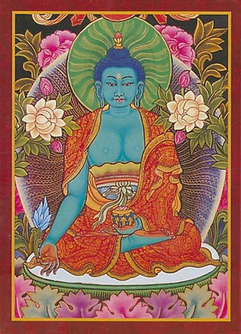
NIRVANA
Goal is to reach NIRVANA- a condition of wanting nothing, a calmness, great insight & happiness.
Two types of Buddhists- one believes Buddha is a teacher, one believes he is a god.

Slide 15
Religious books
The Tripitaka (Pali Canon),
Mahayana Sutras
the Tibetan Book of the Dead
are three major noncanonical Buddhist texts. The Pali Canon, which means “the word of Buddha,” includes some of the Buddha's discourse, but it also incorporates the teachings of his pupils.

Slide 16
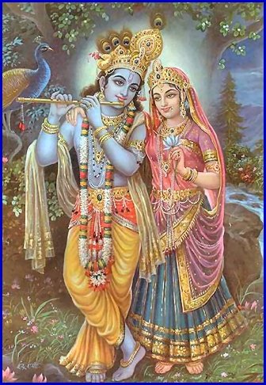
HINDUISM
Oldest major religion. Started 1000’s of years ago.
Group of people called Aryans traveled Asia, conquered towns & adopted their cultures & religions.

Slide 17
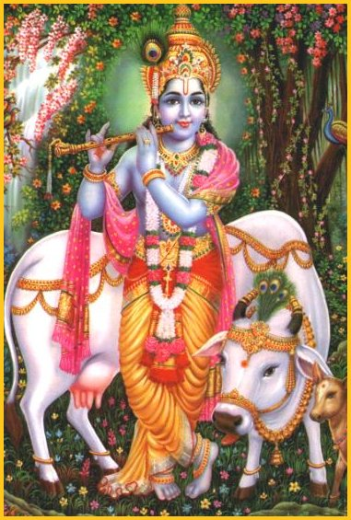
HINDUISM’S BEGINNINGS
Eventually grew into Hinduism.
No single founder.
Worship many gods (polytheistic)
There are many SECTS- that worship one or another gods.

Slide 18


THE BELIEFS
People suffer from pain & sorrow because they chase after false goals such as material goods.
True goal is MOKSHA- free soul from body so soul can join the ATMAN or universal soul
CANNOT achieve MOKSHA in one lifetime so you need reincarnation.

Slide 19

CYCLE OF REBIRTH
Reincarnation is REBIRTH of the soul in various forms (you keep coming back until you overcome your weaknesses)
KARMA- belief that all good & bad actions, mental or physical, affect people’s fate in their next life.
Present life is result past behavior.

Slide 20
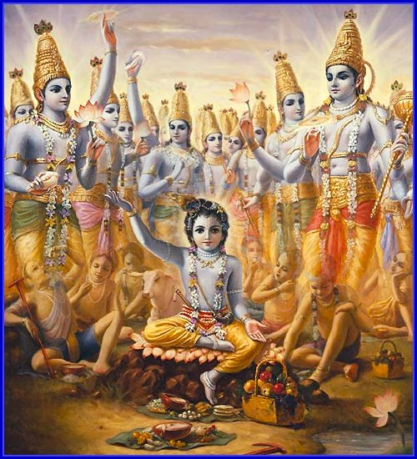
THE BELIEFS
DHARMA- every Hindu has a duty or obligation to their CASTE (social class)
You can improve your position in your next life by fulfilling duties in this life.

Slide 21



THE CASTE SYSTEM
Caste is a strict religious & social order.
You are BORN into a caste or class, & cannot move out of the caste in THIS life.
Your position is a result of karma form previous life.
Very strict rules: Cannot marry or associate with people outside of caste.

Slide 22
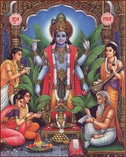
THE CASTES
BRAHMINS: priest
KSHATRIYAS: warriors
VAISH- landowners & merchants
SUDARS: servants, peasants&
Untouchables

Slide 23
SACRED HINDU BOOKS.
Basically Hindu religion is based on the concept of Waidh, which means knowledge or science. “Waidh is not the name of a special book” says Dr. Surindharnath Das Gupta., who is a principal at the Sanscresal College Calcutta.
According to him “ Waidh is the compilation of the 2000 years old collective experiences and studies shared by the different sects of people who came from different places and directions of Hindustan”. hence following are the names of the different books of Hinduism”

Slide 24
BOOKS.
WAIDH: 2000 year old shared experiences of different Hindus. this book is further divided in four waidh: Rug waidh, Sam Waidh, Yaghar Waidh and Ather waid.
UPANISHAND: strong directions regarding Ghayan and Meditation( muraqba)
3. RAMYAN(1000 B.C) AND MAHABHARAT: written in 1200 B.C, based on the religious education
4. GEETA: A compilation of Shree Krishen jhi Maharaj directives.

Slide 25
SACRED STATUES OF HINDUISM
Hindus basically worship thousands of statues in the temple, but three of these are given more superiority than others:
BHARHMA: He created every thing in the world but as the world came into being it was of no use.
WISHNU: he has the power of controlling the human life.
SHIVA : He takes away the human lives.

Slide 26
JUDAISM (ZOINISM)
INTRODUCTION: Judaism includes the people who call themselves Bani Israel ( sons of Allah). and it was the title of Hazrat Jacob( yaqqob A.S.W)
Saturday is their holiday called ( Yom-us-Sabt). they are always busy in hatching conspiracies.
They claim that they are the chosen one from God. they consider themselves to be the pure and superior of all other religions and nations.

Slide 27

JUDAISM
Among world’s oldest religions.
Nomads est. the kingdom of Israel in 1800 BC.
Kingdom weakened by rule of Solomon (taxed heavily) people rebelled.

Slide 28

Jews exiled from Palestine, returned & exiled again when the Romans took over.
Many Jews began to return to Israel in the 1900s & Israel becomes a Jewish nation in 1948.

Slide 29

MOSES
Moses was 1st prophet.
He introduced the 10 Commandments.
Also became part of Christianity.

Slide 30


TEACHINGS OF JUDAISM
Jews God’s chosen people.
Must obey god & all of his laws.
People are responsible for their own actions.
No one can love god without loving their neighbor. More concerned with helping people in present, than in life after death.

Slide 31

Govts are not as good as they could be so there will be a kingdom of god on Earth

Slide 32
BOOKS OF JUDAISM
The Old Testament (also known as the Jewish Tanakh) is the first 39 books in most Christian Bibles( genesis, exodus,leveticus etc)
oLD TESTAMENT:
it comprises of :
Taurat and Zabur

Slide 33
CHRISTAINITY
This religion is based on the teaching of Hazrat Essas (Jesus Christ)
The believers of the religion are called Christian.
Jesus Christ was given birth throw the body of Bibi Maryam ( the Marry)
Jesus Christ came in this world at 4 B.C and was carried away in the skies at 29th B.C.
This religion is based on the concept of Trinity.

Slide 34
BELIEFS
Christianity was heavily influenced by Judaism. Some of the major beliefs of Christianity are:
Monotheism - There is one god who is all powerful and all knowing.
Jesus Christ died for the sins of humankind.
Salvation comes from faith in God.

Slide 35
Christianity
Some branches of Christianity are:
Roman Catholicism
Protestantism
Eastern Orthodox.

Slide 36

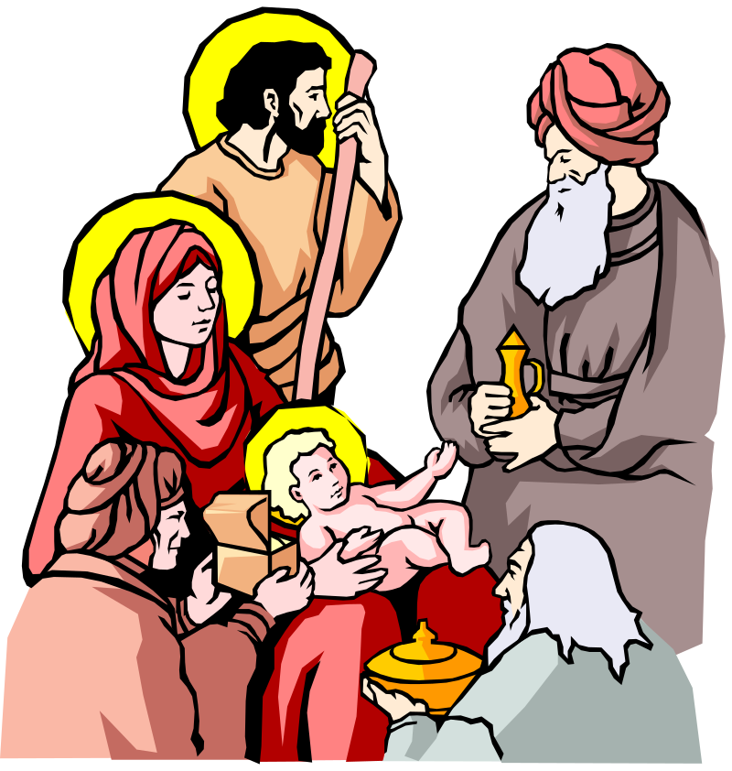
CHRISTIANITY
Began in Palestine.
Story is in Gospels of the Bible.
Jesus born in Bethlehem.
Worked as a carpenter & studied under Rabbis.

Slide 37
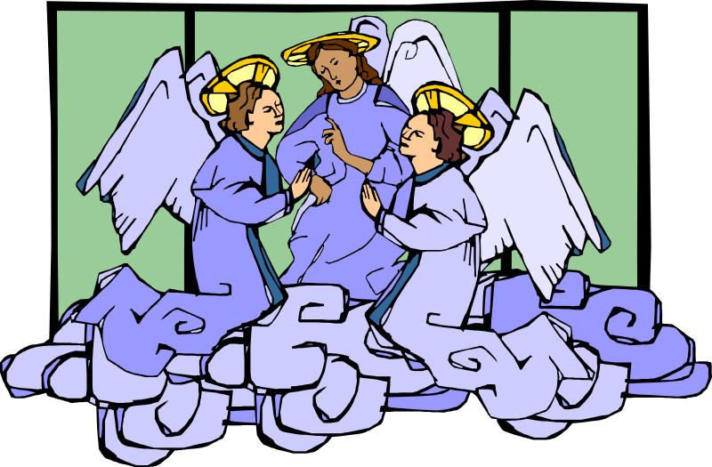
CHRISTIANITY
At 30, became a preacher, teaching about God’s goodness & attracting many followers.
Jewish prophets had predicted a messiah would save the Jews form foreign rule.

Slide 38
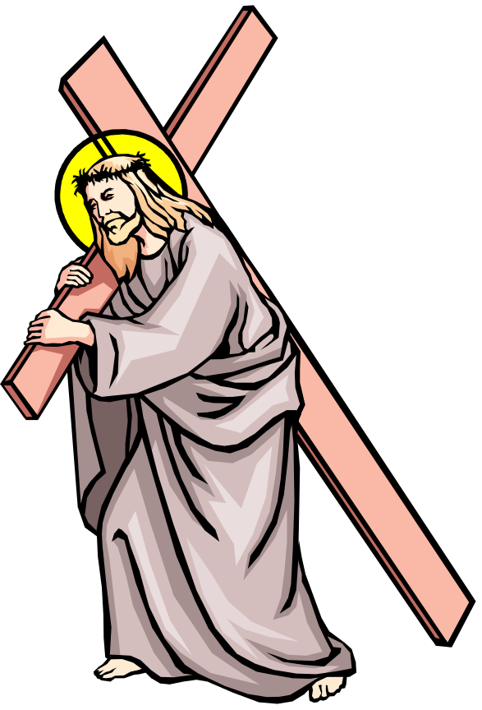
CHRISTIANITY
Jewish & Roman leaders saw him as a troublemaker when he refused to recognize Roman leaders as gods.
Executed 33 AD.

Slide 39

TEACHINGS OF CHRISTIANITY
Believe in one god who is loving and forgiving.
Be compassionate to others
All equal & loved by god.
Will be rewarded for belief with eternal life.
Follow the teachings of Christ & the Bible
Belief that Jesus is the son of God.

Slide 40
HOLY BOOKS OF CHRISTIANITY
Christians believe the Old and New Testaments of the Bible. The first four books of the New Testament were written by followers of Jesus.
New testament = BIBLE: it is further divided in the following books:
MATTI
LUQUS
MARQAS
YOHANNA

Slide 41

ISLAM
Began on Arabian Peninsula 600 AD.
Muhammad was an orphan who worked for woman named Khadija as a caravan leader.

Slide 42
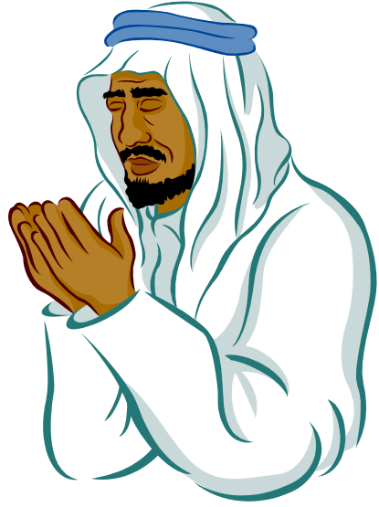
He married her
Thought he was spiritual.
Went away, fasted & believed had heard word of God

Slide 43

ISLAM
Became a prophet, to preach about the word of God.
Taught in Mecca, but was driven out due to fear. He went to Medina.
His following grew & he gathered forces & returned to Mecca.

Slide 44
FIVE PILLARS OF ISLAM
Pray to one god & believe that Muhammad is his prophet.
Pray 5 times a day facing Mecca.
Give charity to the poor & old. Share with others.
Fast during the Holy Month of Ramadan
Take a HAJJ- a pilgrimage to Mecca.

Slide 45
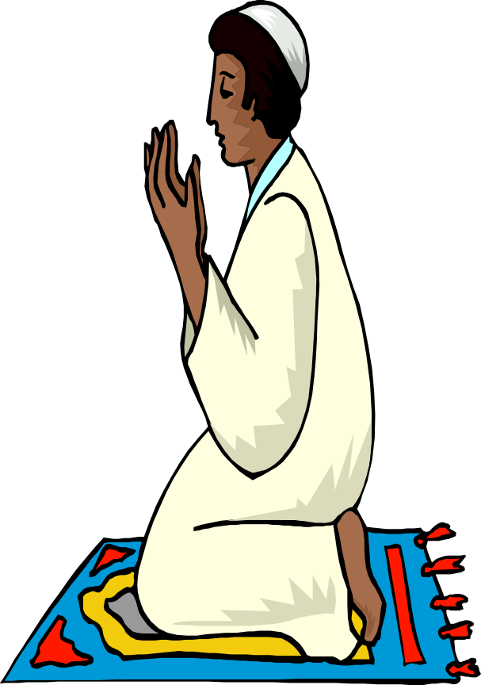

ISLAM
Muslims worship at noon on Fridays in a MOSQUE.
Islam spread quickly.
Most people speak Arabic.
Koran is the
religious book.

